Slide 1
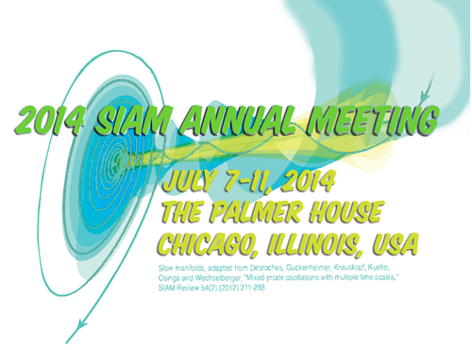
Writing for Success: Applying for Funding
Sven Leyffer
Argonne National Laboratory

Slide 2
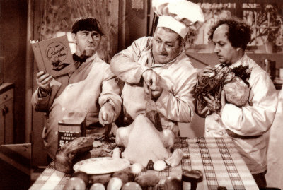
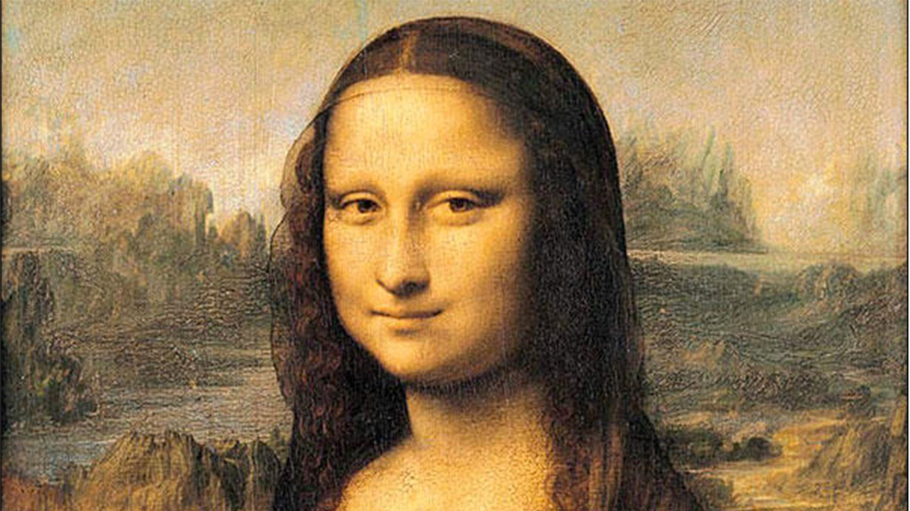
Ingredients of Good Proposals
Before you apply for funding … write the call:
Volunteer for funding workshops & white papers
Participate in forward-looking and funding panels
Talk to your program managers
Strong introduction and motivation
Compelling scientific case and research plan
Preliminary results are helpful
= 10³ words

Slide 3
Nuts and Bolts of a Proposal
Read the call & address evaluation criteria
Note differences between DOE and NSF calls e.g. “Relevance to DOE” vs. “Broader Impact” (NSF)
Stick to proposal template & rules: fonts, margins
Use all pages: \baselinskip & \wrapfigure
Use deadlines/checklist for your writing process
Collect supplementary material: budget, CV, …
Always use a spill-choker
Proof-read your proposal multiple times!
Never write a math proposal in Word
Avoid tiny print and highlights in yellow

Slide 4
Social Aspect of Proposals
Check out other funded proposals, e.g. NSF’s http://www.nsf.gov/awardsearch/
Ask your mentor or colleagues to read your proposal & provide feed-back
Learn by writing proposals with colleagues
Tips for large collaborative proposals:
Negotiate funding scenarios (cuts) ahead of time
Use cvs, svn, git, et al.
Learn from the reviews … helpful!
Try-and-try again … you will succeed!

